Slide 1
Random Signals
Basic concepts
Bibliography
Oppenheim’s book, Appendix A.
Except A.5.
We study a few things that are not in the book.

Slide 2
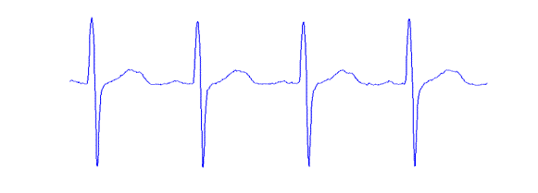
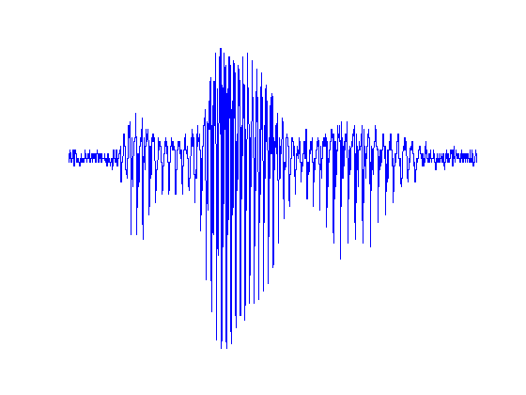
Motivation
Most signals that we process can be considered to be random.
Examples: speech, audio, video, digital communication signals, medical, biological and economic signals.
Electrocardiogram
speech

Slide 3
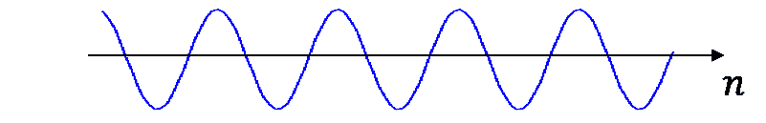


Is this a random signal?
$$x(n) = A cos⁡(ωn+φ)$$
Yes, if $A$, $ω$ or $φ$ are random variables!

Slide 4
Mathematical models
All signals that we process have finite length. However, it is often useful to consider them as being of infinite length.
finite-length – random vectors
random signals
infinite-length – random processes
(stochastic processes)

Slide 5


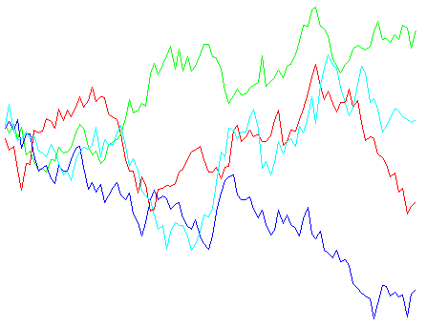
Finite-length signals
A finite-length signal
can be considered as an N-dimensional vector
realizations of x

Slide 6
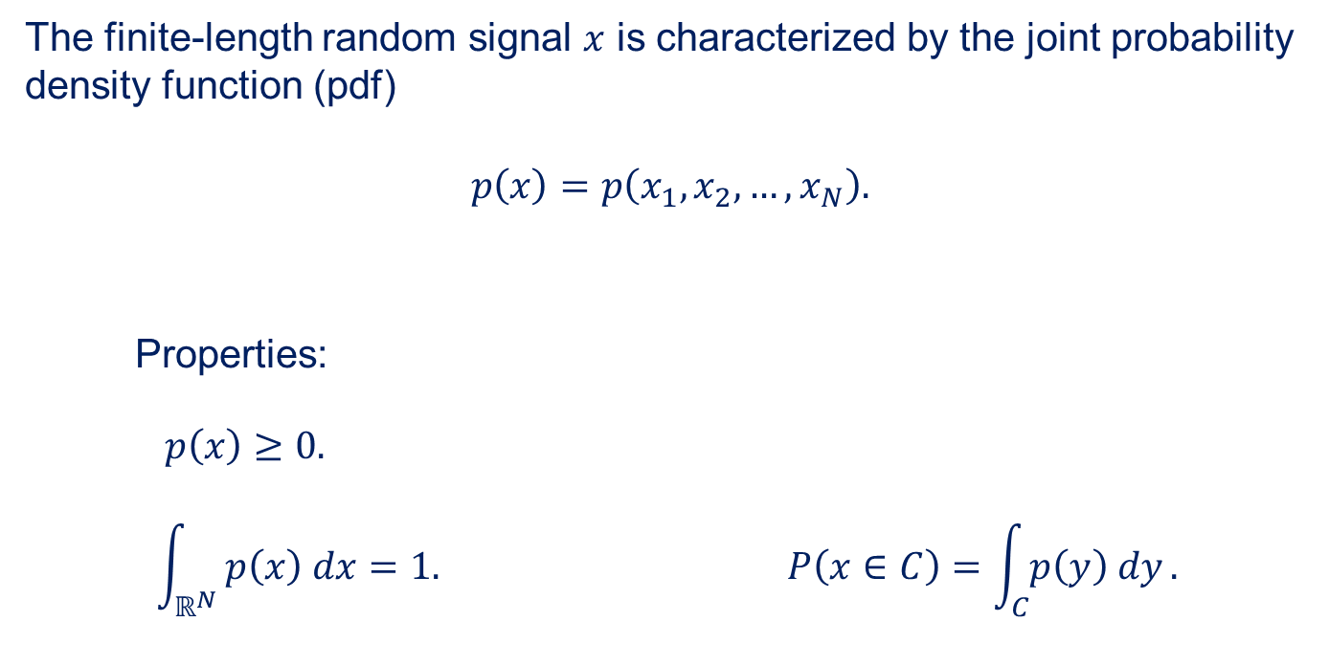
Full description
The finite-length random signal $x$ is characterized by the joint probability density function (pdf)
$$p\left(x\right)=p\left(x_{1},x_{2},…,x_{N}\right).$$
Properties:
$$p\left(x\right)≥0.$$
$$\int_{ℝ^{N}}{ p\left(x\right) dx}=1. P\left(x∈C\right)=\int_{C}{p\left(y\right) dy}.$$

Slide 7


The whole is not just the sum of its parts
If we know the distribution of each variable $xn$, can we obtain their joint distribution?
No
The distributions of the variables$xn$ do not contain information about their mutual relationships (mutual dependence).

Slide 8
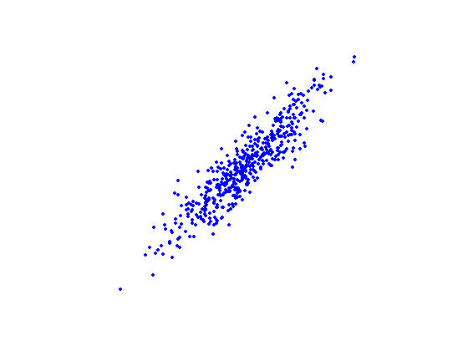
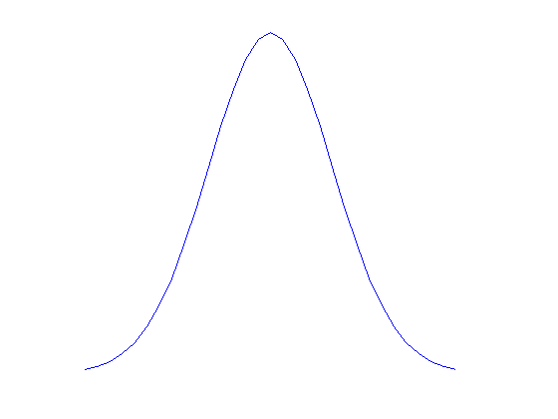
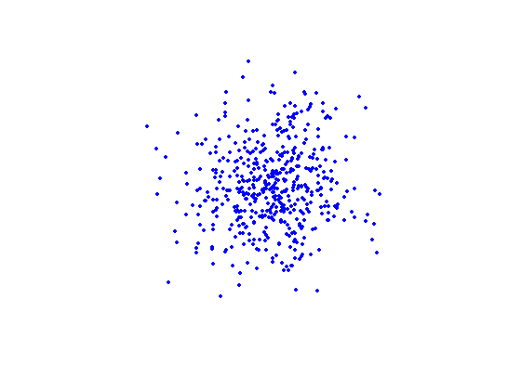





Example
$$x={\left[x_{1},x_{2}\right]}^{T}$$
$$p(x1)$$
$$x1$$
$$p(x_{2})$$
$$x2$$
Both joint distributions have the same marginal distributions $p(x1)$ and $p(x2)$.

Slide 9

Independent random variables
The random variables $x1, …,x_{N}$ are independent iff
In this case, the joint distribution can be obtained from the marginal distributions $p(x_{n})$. No additional information is needed.

Slide 10

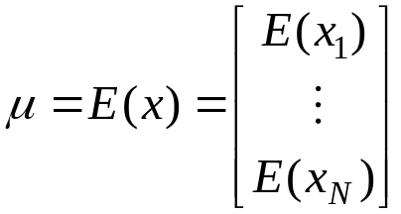
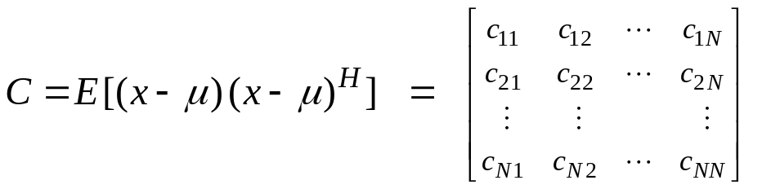


Second-order description
Notation:
A random vector $x$ can be partially characterized by
Mean vector
(Auto)covariance matrix
In some cases, this description is all we need.

Slide 11
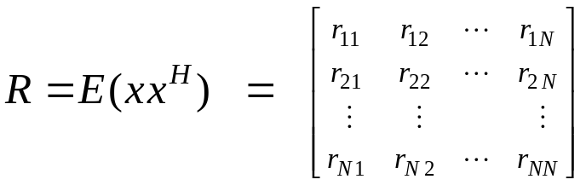



Also often used:
(Auto)correlation matrix
Relationship with autocovariance:
Note: In Statistics, correlation has a different meaning than here!

Slide 12
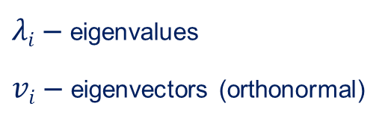
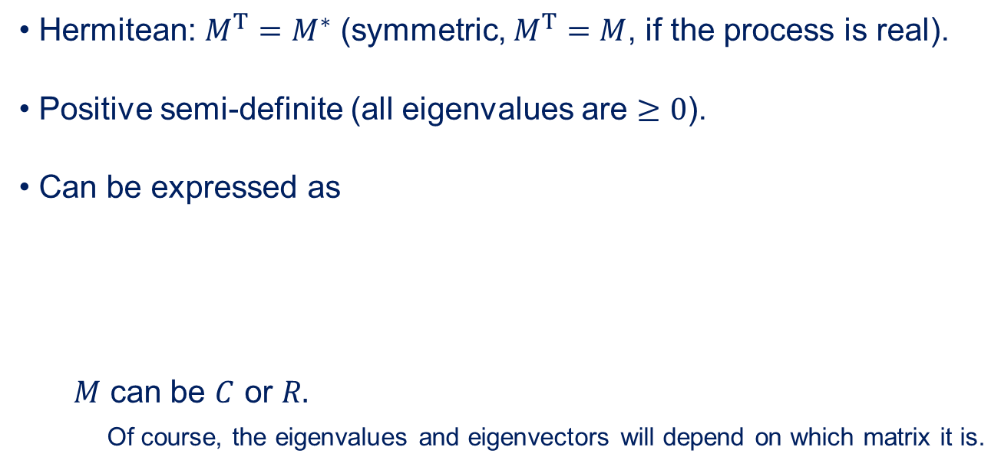
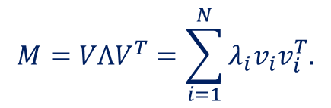
Properties of autocovariance and autocorrelation matrices
Hermitean: $M^{T}=M^{∗}$ (symmetric, $M^{T}=M$, if the process is real).
Positive semi-definite (all eigenvalues are $≥0$).
Can be expressed as
$M$ can be $C$ or $R.$
Of course, the eigenvalues and eigenvectors will depend on which matrix it is.
$$M=VΛV^{T}=\sum_{i=1}^{N}{λ_{i}v_{i}v_{i}^{T}.}$$
$λi$ – eigenvalues
$vi$ – eigenvectors (orthonormal)

Slide 13
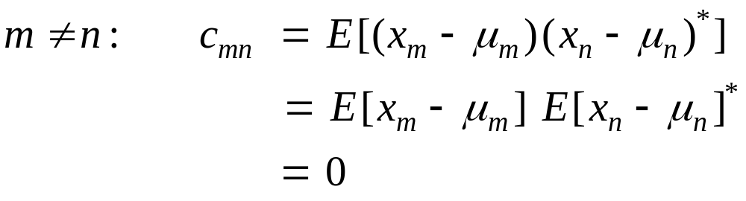
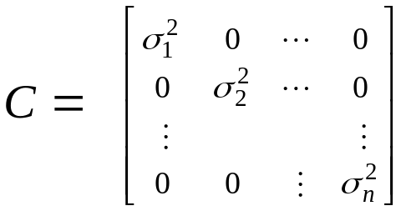

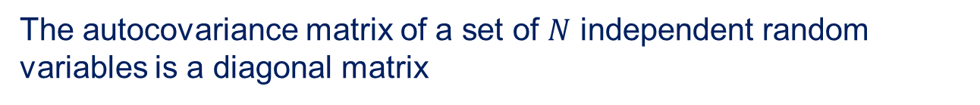
Covariance of independent variables
The autocovariance matrix of a set of $N$ independent random variables is a diagonal matrix
Independence

Slide 14
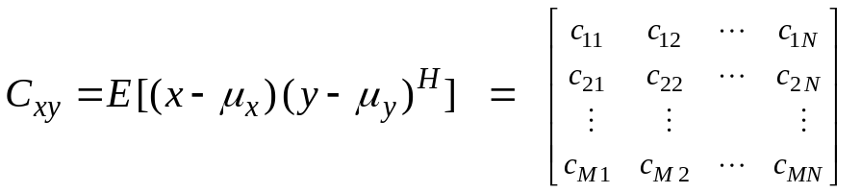

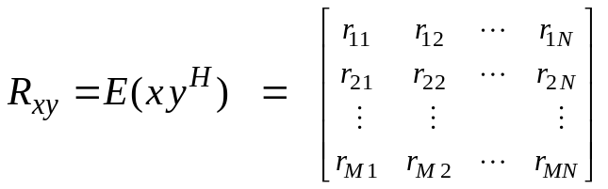

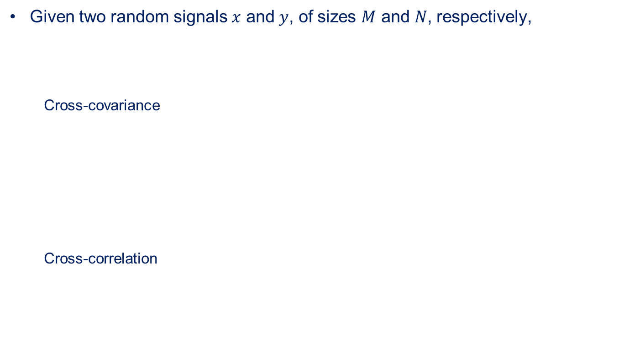
Cross-covariance and cross-correlation
Given two random signals $x$ and $y$, of sizes $M$ and $N$, respectively,
  Cross-covariance
  Cross-correlation

Slide 15
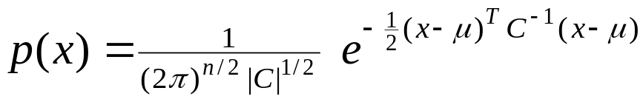
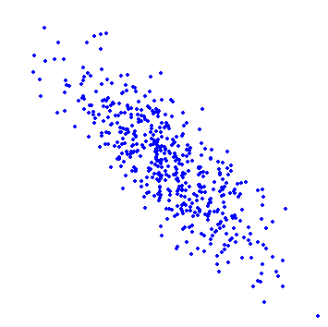
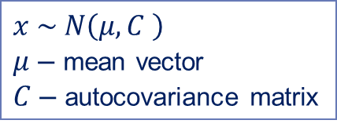
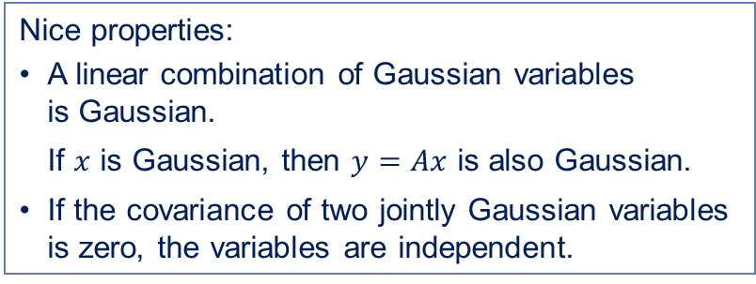


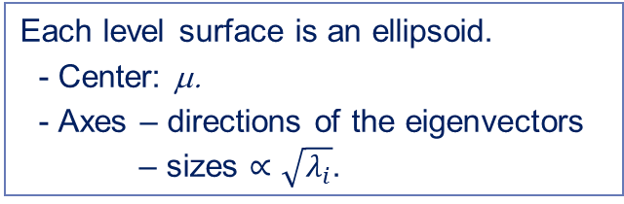
Normal (Gaussian) distribution for real variables
$x \sim N\left(μ,C \right)$
$μ$ – mean vector
$C$ – autocovariance matrix
quadratic form
constant
$$\sqrt{λ_{1}}v_{1}$$
Each level surface is an ellipsoid.
- Center: μ.
- Axes – directions of the eigenvectors
– sizes $∝\sqrt{λ_{i}}$.
$$\sqrt{λ_{2}}v_{2}$$
Nice properties:
A linear combination of Gaussian variables
is Gaussian.
If $x$ is Gaussian, then $y=Ax$ is also Gaussian.
If the covariance of two jointly Gaussian variables
is zero, the variables are independent.
μ

Slide 16
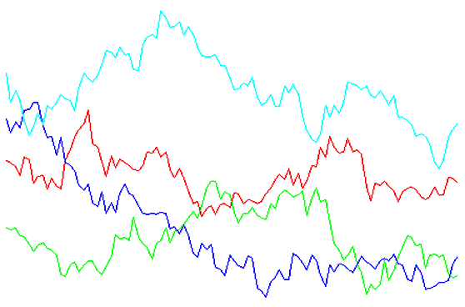
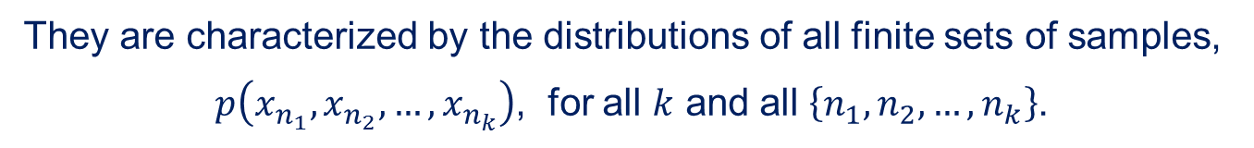
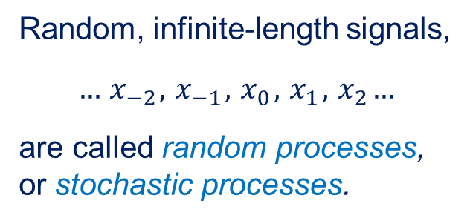
Infinite-length signals
Random, infinite-length signals,
$$…{ x}_{−2},{ x}_{−1}, { x}_{0},{ x}_{1},{ x}_{2}…$$
are called random processes,
or stochastic processes.
realizations of a stochastic process
Their characterization is more difficult than for finite-length random signals.
They are characterized by the distributions of all finite sets of samples,
$p\left(x_{n_{1}},x_{n_{2}},…,x_{n_{k}}\right)$, for all $k$ and all $\left\{n_{1},n_{2},…,n_{k}\right\}$.

Slide 17


Second-order description
A partial description of a random process $x$ is based on the first- and second-order statistics:
Mean
Autocovariance function
[Autocorrelation function]
Gaussian processes
A process is Gaussian if the joint distribution of any set of samples is Gaussian.
A Gaussian process is completely characterized by its second-order description.

Slide 18
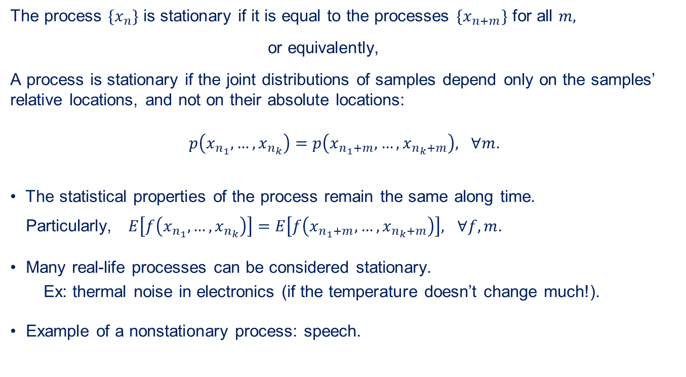
Stationary processes
The process $\{x_{n}\}$ is stationary if it is equal to the processes $\{x_{n+m}\}$ for all $m,$
or equivalently,
A process is stationary if the joint distributions of samples depend only on the samples’ relative locations, and not on their absolute locations:
$$p\left(x_{n_{1}},…,x_{n_{k}}\right)=p\left(x_{n_{1}+m},…,x_{n_{k}+m}\right), a∀m.$$
The statistical properties of the process remain the same along time.
Particularly, $E\left[f\left(x_{n_{1}},…,x_{n_{k}}\right)\right]=E\left[f\left(x_{n_{1}+m},…,x_{n_{k}+m}\right)\right], a∀f,m$.
Many real-life processes can be considered stationary.
Ex: thermal noise in electronics (if the temperature doesn’t change much!).
Example of a nonstationary process: speech.

Slide 19
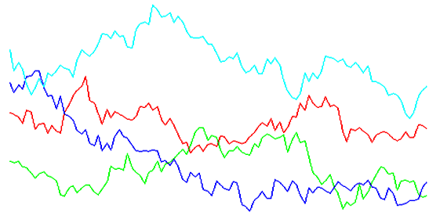
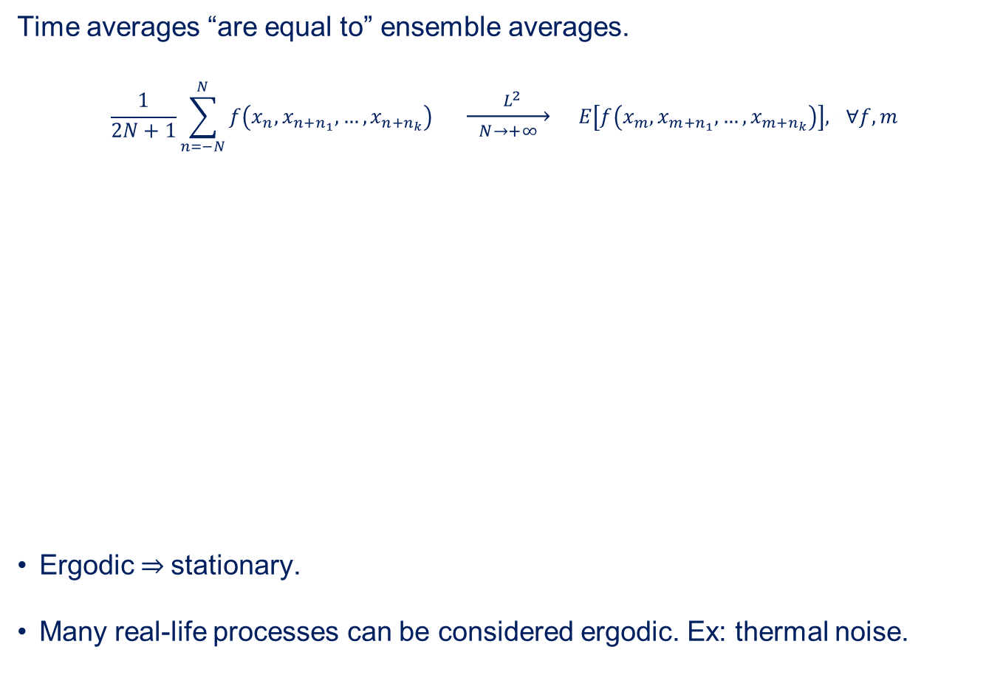

Ergodic processes
Time averages “are equal to” ensemble averages.
$$\frac{1}{2N+1}\sum_{n=−N}^{N}{f\left(x_{n},x_{n+n_{1}},…,x_{n+n_{k}}\right)} \underset{N→+∞}{\underset{→}{ { L}^{2} }} E\left[f\left(x_{m},x_{m+n_{1}},…,x_{m+n_{k}}\right)\right],a∀f,m$$
Ergodic $⇒$stationary.
Many real-life processes can be considered ergodic. Ex: thermal noise.
mean-square convergence
$$f$$
time average
time average
ensemble average

Slide 20
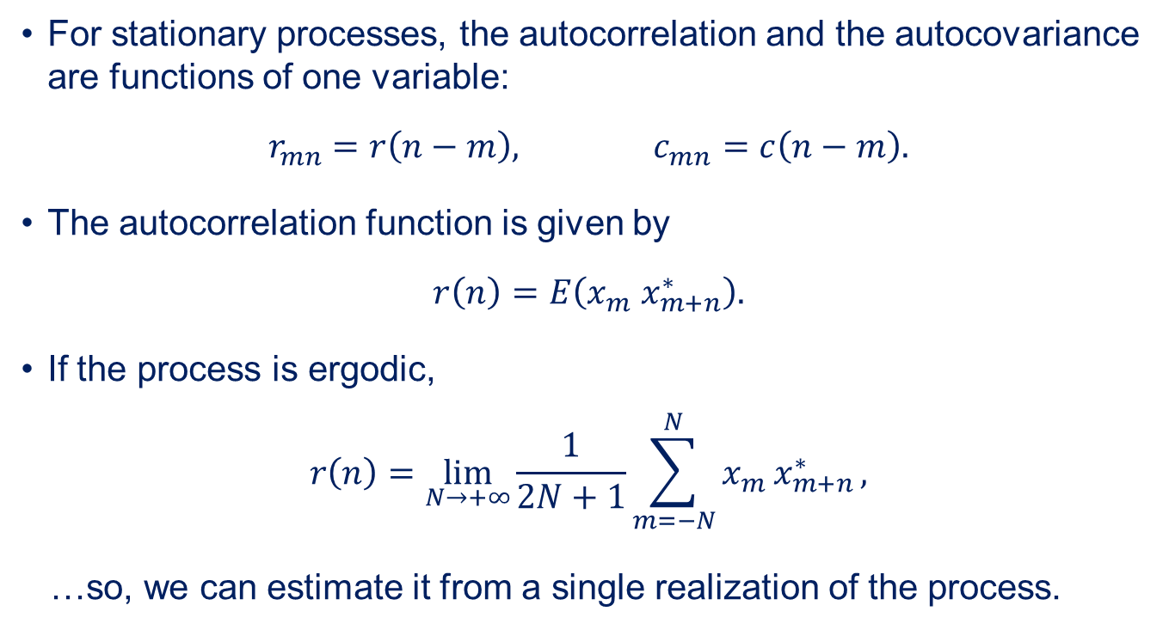
Autocorrelation of stationary processes
For stationary processes, the autocorrelation and the autocovariance are functions of one variable:
$$r_{mn}=r\left(n−m\right), c_{mn}=c\left(n−m\right).$$
The autocorrelation function is given by
$$r\left(n\right)=E\left(x_{m}{ x}_{m+n}^{∗}\right).$$
If the process is ergodic,
$$r\left(n\right)=\lim_{N→+∞}{\frac{1}{2N+1}\sum_{m=−N}^{N}{x_{m }x_{m+n}^{∗}}},$$
…so, we can estimate it from a single realization of the process.

Slide 21
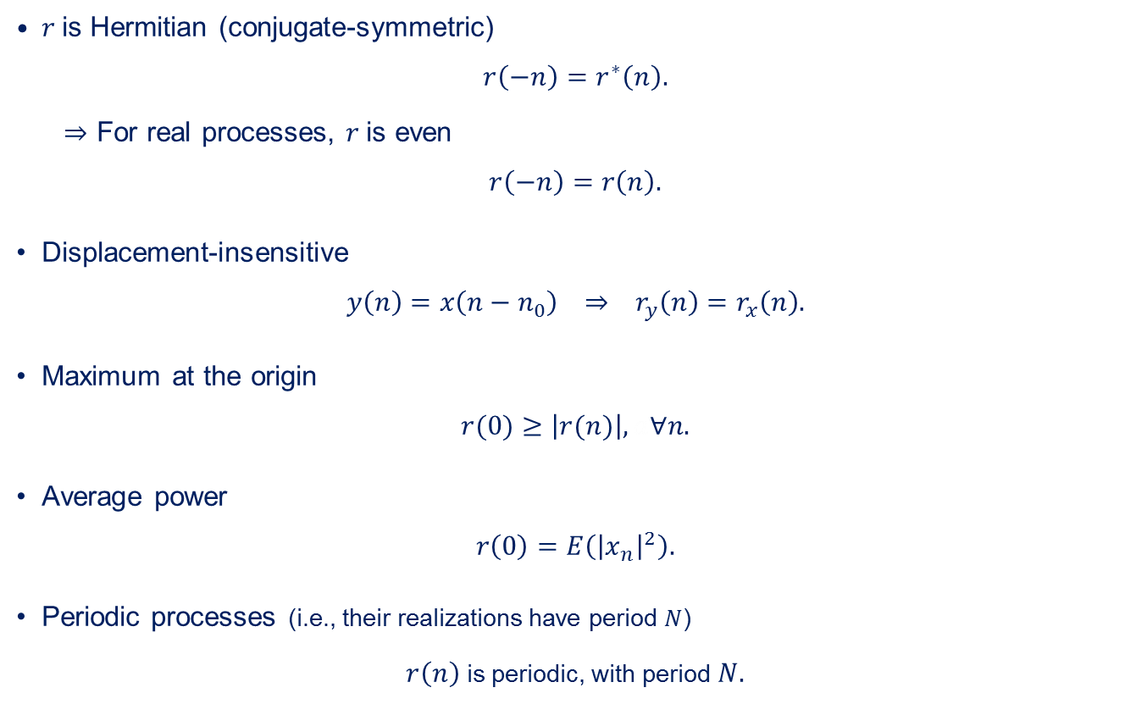
Properties of the autocorrelation function
$r$is Hermitian (conjugate-symmetric)
$$r\left(−n\right)=r^{∗}\left(n\right).$$
$⇒$ For real processes, $r$is even
$$r\left(−n\right)=r\left(n\right).$$
Displacement-insensitive
$${y\left(n\right)=x\left(n−n_{0}\right) ⇒ r}_{y}\left(n\right)=r_{x}\left(n\right).$$
Maximum at the origin
$$r(0)≥\left|r(n)\right|, a∀n.$$
Average power
$$r\left(0\right)=E\left({\left|x_{n}\right|}^{2}\right).$$
Periodic processes (i.e., their realizations have period $N$)
$r\left(n\right)$ is periodic, with period $N.$

Slide 22

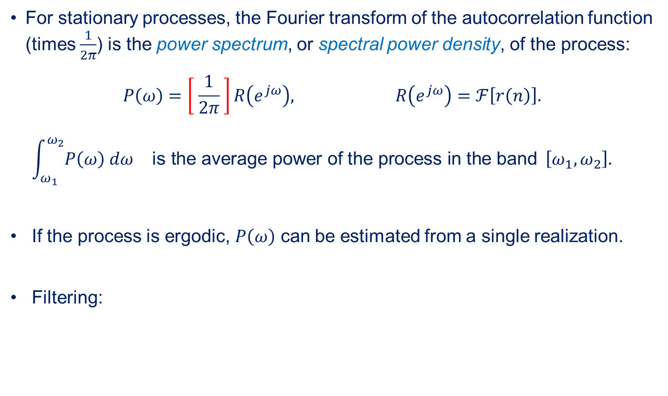



Power spectrum of stationary processes
For stationary processes, the Fourier transform of the autocorrelation function (times $\frac{1}{2π}$) is the power spectrum, or spectral power density, of the process:
$$P\left(ω\right)=\left[ \frac{1}{2π} \right]R\left(e^{jω}\right), R\left(e^{jω}\right)=ℱ\left[r\left(n\right)\right].$$
$$\int_{ω_{1}}^{ω_{2}}{P\left(ω\right) dω} \text{is} \text{the} \text{average} \text{power} \text{of} \text{the} \text{process} \text{in} \text{the} \text{band} \left[ω_{1},ω_{2}\right].$$
If the process is ergodic, $P\left(ω\right)$ can be estimated from a single realization.
Filtering:
$$x$$
$$y$$
$P_{y}\left(ω\right)={\left|H\left(e^{jω}\right)\right|}^{2}P_{x}\left(ω\right)$.
$$H\left(e^{jω}\right)$$

Slide 23
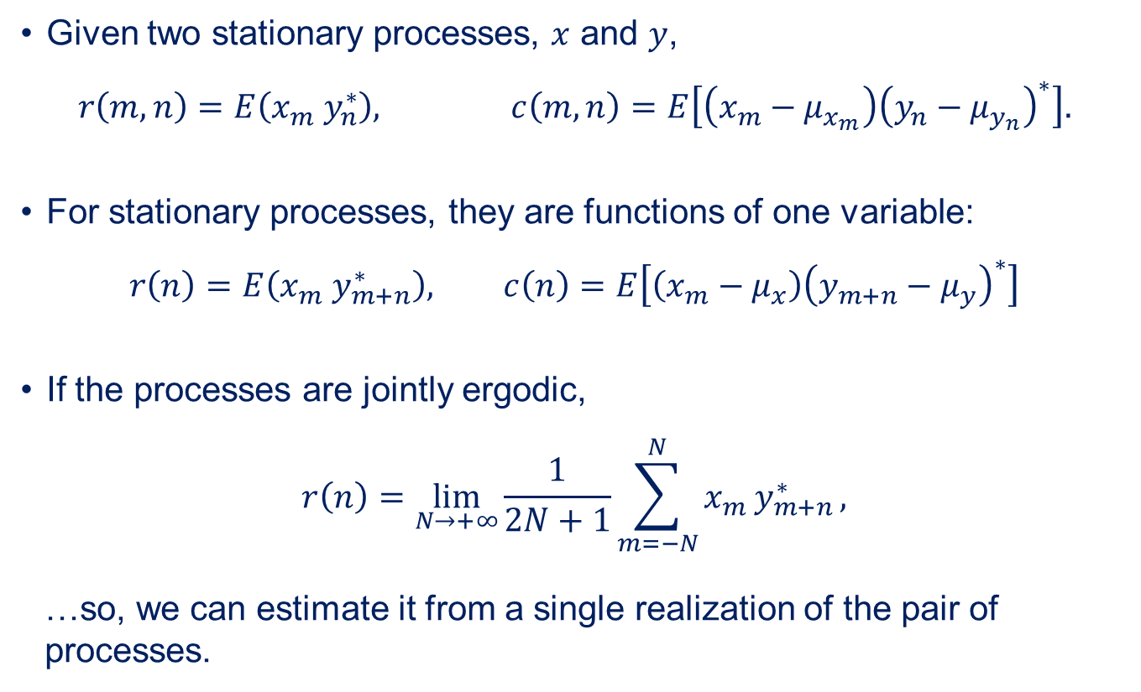
Cross-correlation and cross-covariance
Given two stationary processes, $x$ and $y$,
$$r\left(m,n\right)=E\left(x_{m} y_{n}^{∗}\right), c\left(m,n\right)=E\left[\left(x_{m}−μ_{x_{m}}\right){\left(y_{n}−μ_{y_{n}}\right)}^{∗}\right].$$
For stationary processes, they are functions of one variable:
$$r\left(n\right)=E\left(x_{m}{ y}_{m+n}^{∗}\right), c\left(n\right)=E\left[\left(x_{m}−μ_{x}\right){\left(y_{m+n}−μ_{y}\right)}^{∗}\right]$$
If the processes are jointly ergodic,
$$r\left(n\right)=\lim_{N→+∞}{\frac{1}{2N+1}\sum_{m=−N}^{N}{x_{m }y_{m+n}^{∗}}},$$
…so, we can estimate it from a single realization of the pair of processes.

Slide 24
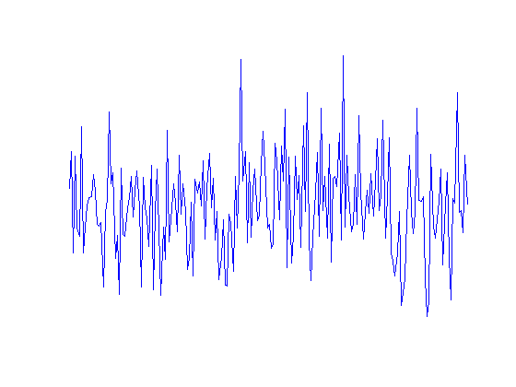
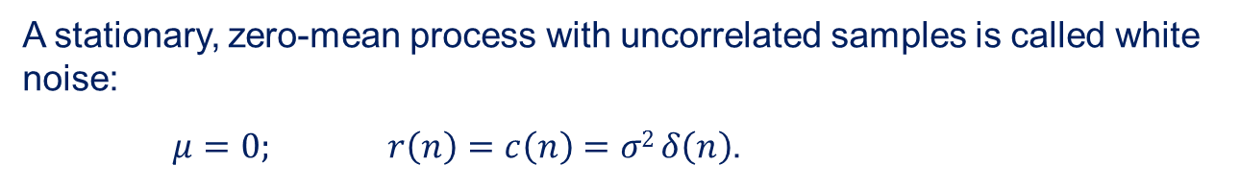
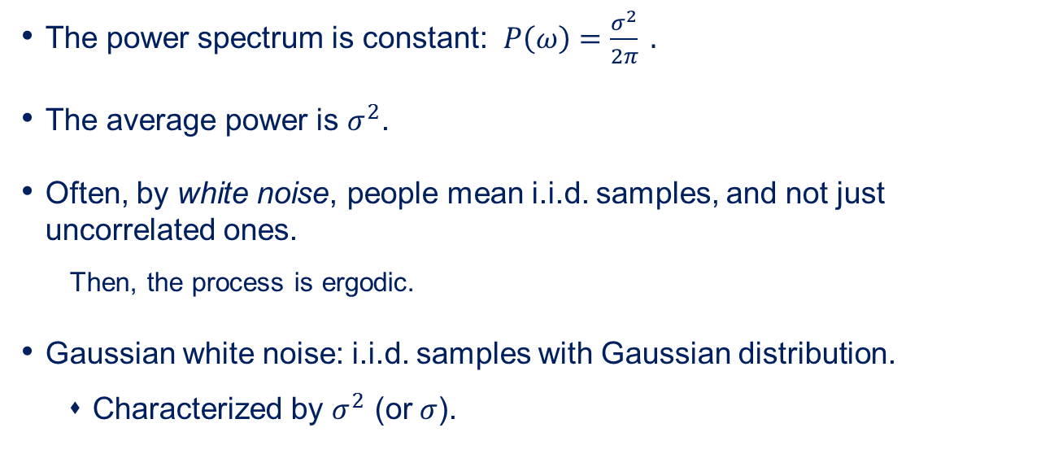
White noise
A stationary, zero-mean process with uncorrelated samples is called white noise:
$μ=0; r\left(n\right)=c\left(n\right)=σ2 δ\left(n\right)$.
The power spectrum is constant: $P\left(ω\right)=\frac{σ^{2}}{2π} .$
  The average power is $σ^{2}$.
Often, by white noise, people mean i.i.d. samples, and not just uncorrelated ones.
  Then, the process is ergodic.
Gaussian white noise: i.i.d. samples with Gaussian distribution.
  Characterized by $σ^{2}$ (or $σ$).

Slide 25
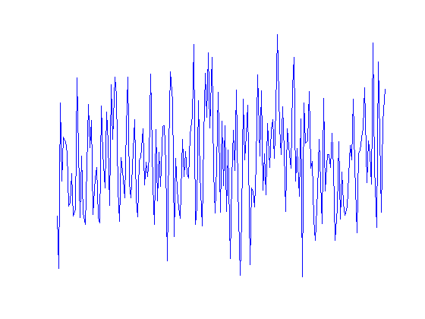
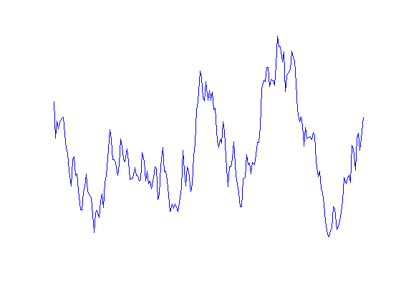





Non-white (colored) noise
We can create correlation among the samples by filtering white noise.
$$x$$
$x_{n}$: white noise
Autoregressive (AR) process (only poles)
$$y_{n}=a_{1 }y_{n−1}+…+a_{p }y_{n−p}+{b_{0 }x}_{n}$$
$$y_{n}=.98 y_{n−1}+x_{n}$$
Moving-average (MA) process (only zeros)
$$y_{n}=b_{0 }x_{n}+…+b_{q}{ x}_{n−q}$$
pink noise
Autoregressive, moving-average (ARMA) process (poles and zeros)
$$y_{n}=a_{1 }y_{n−1}+…+a_{p }y_{n−p}+b_{0}{ x}_{n}+…+b_{q}{ x}_{n−q}$$

