Slide 1
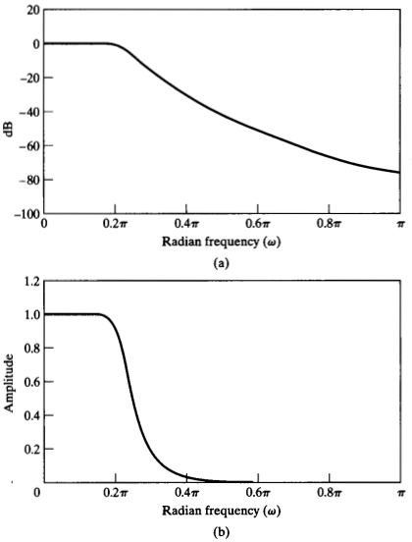


Sampling of h(n): Butterworth low-pass filter
Specifications
0.89125 = –1 dB
0.17783 = –15 dB

Slide 2
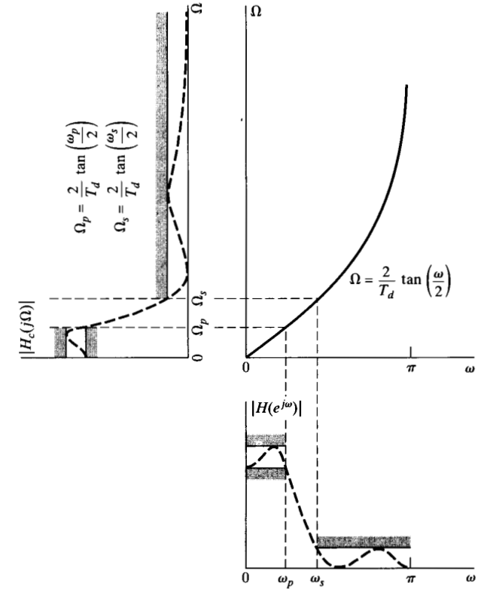
Bilinear mapping: mapping of the specifications

Slide 3
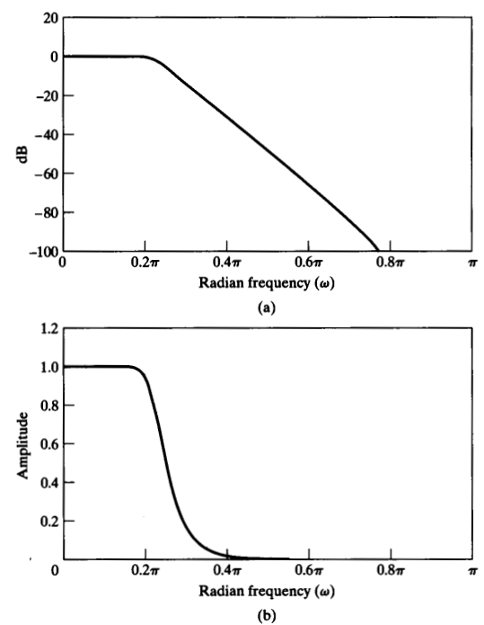

Bilinear mapping: example
Specifications
0.89125 = –1 dB
0.17783 = –15 dB

Slide 4
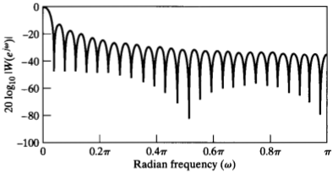

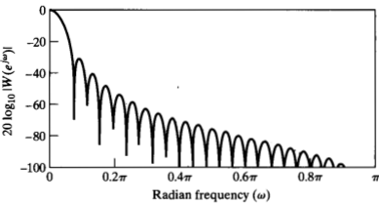

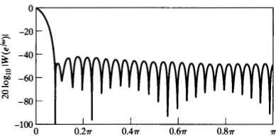

Windows

Slide 5

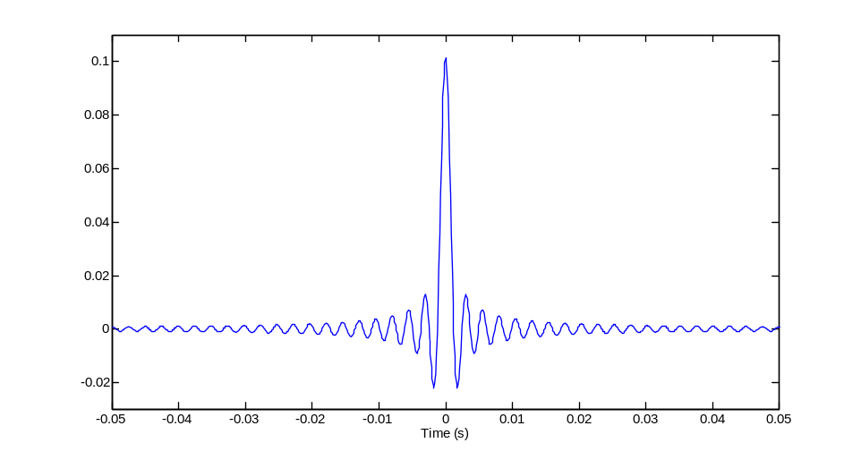
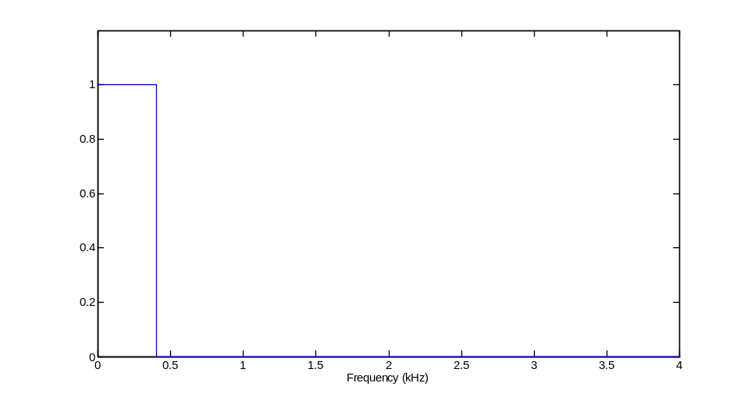
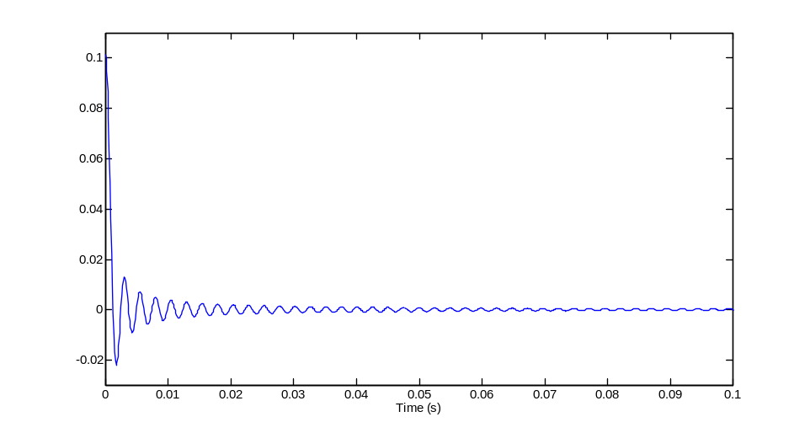
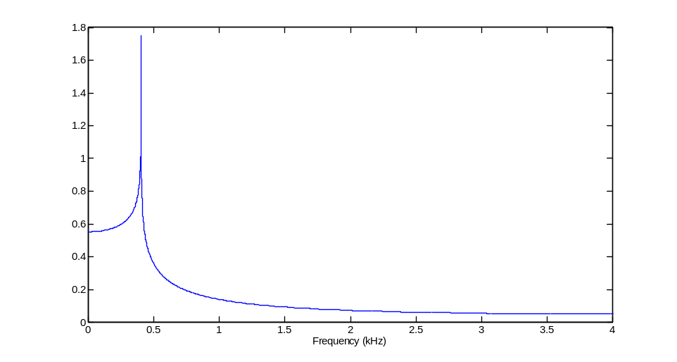
Example: low-pass filter
Original

Slide 6
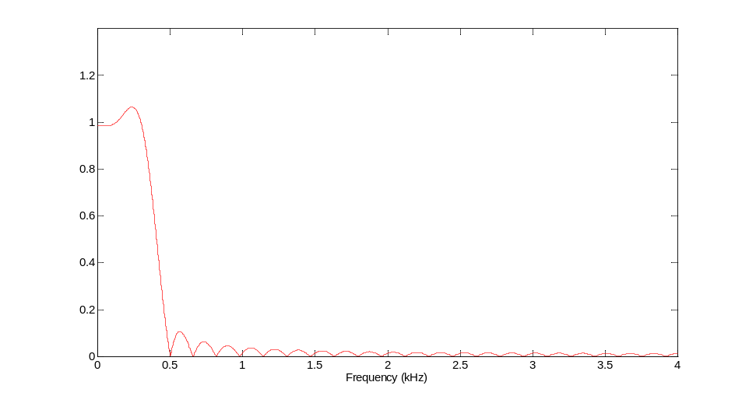
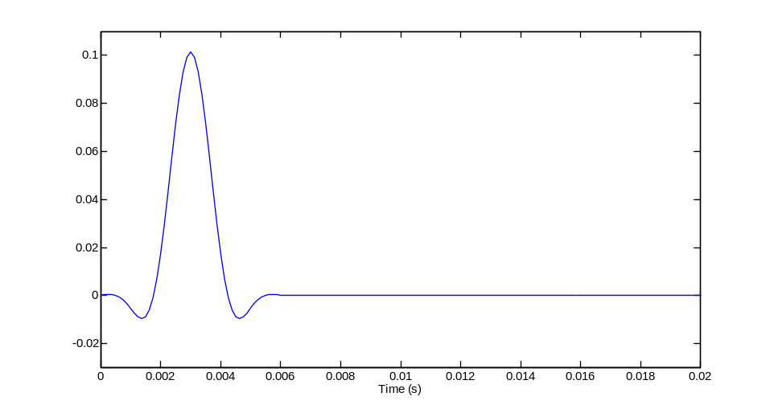
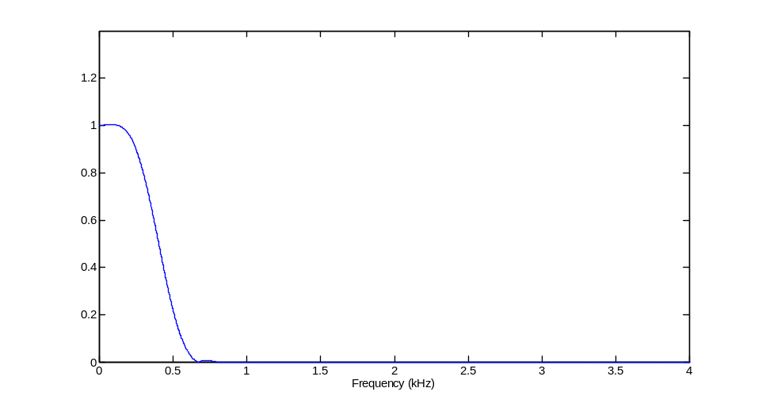
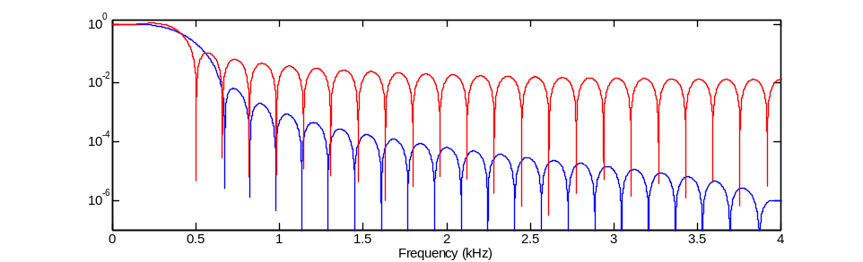
0.1
0.08
0.06
0.04
0.02
0
-0.02
0
0.002
0.004
0.006
0.008
0.01
0.012
0.014
0.016
0.018
0.02
Time (s)
Sampling at 8 kHz
51 samples

Slide 7
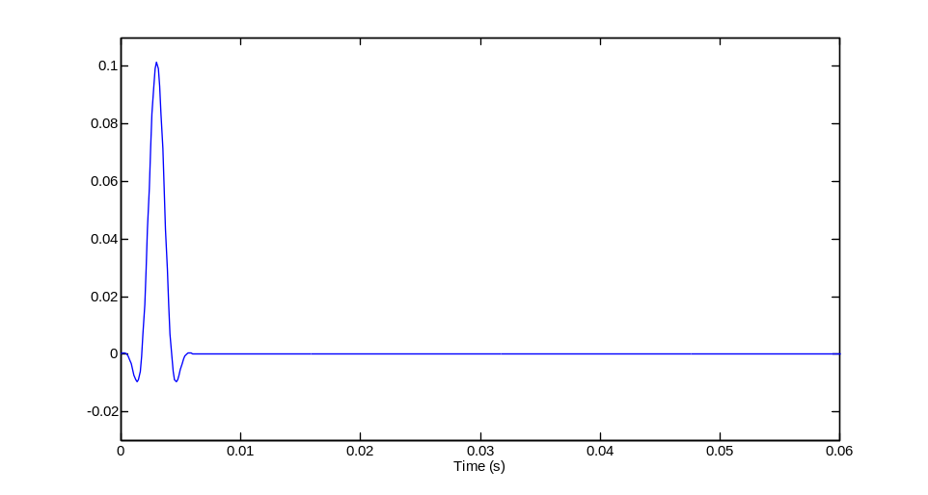
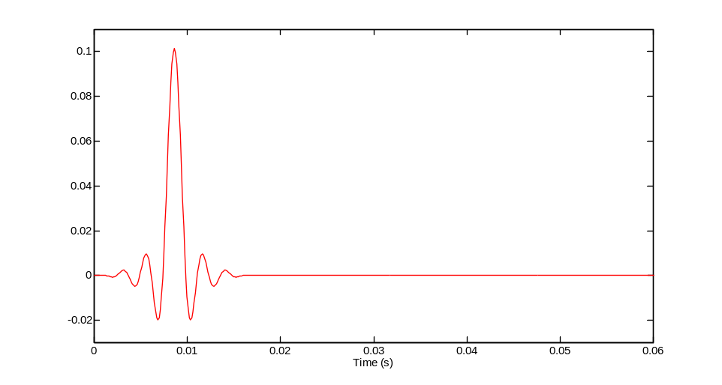
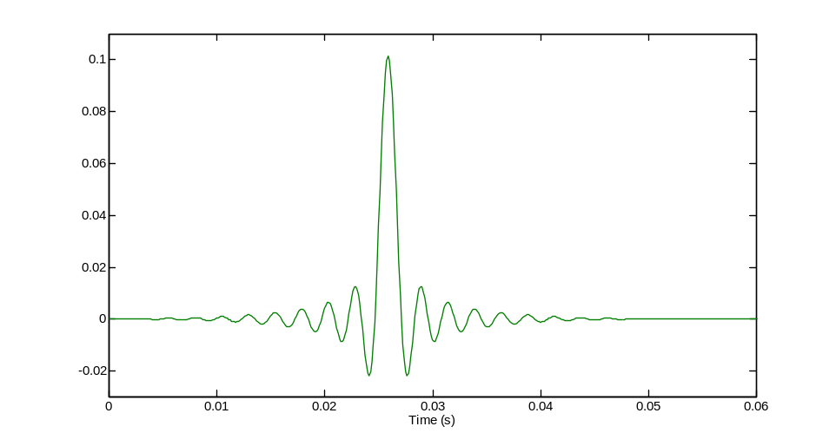
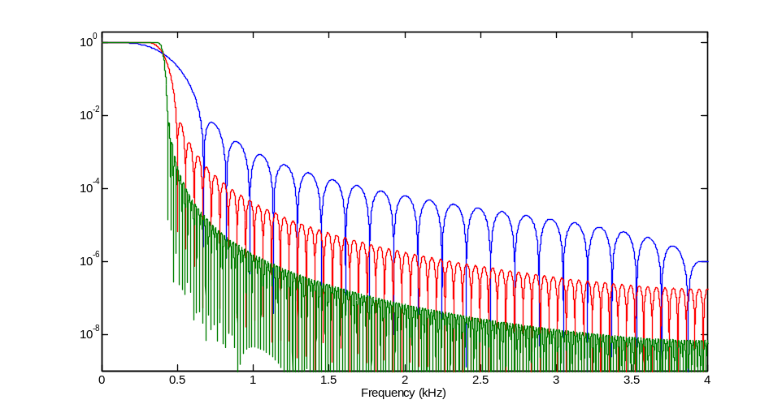
51 samples
101 samples
501 samples

