Slide 1
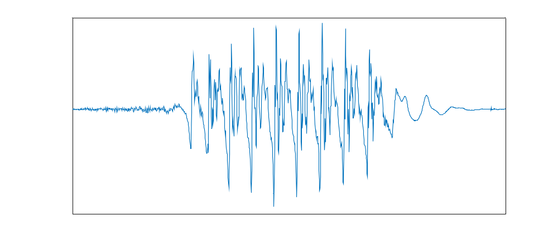
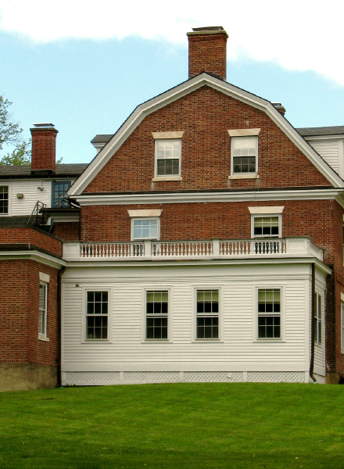
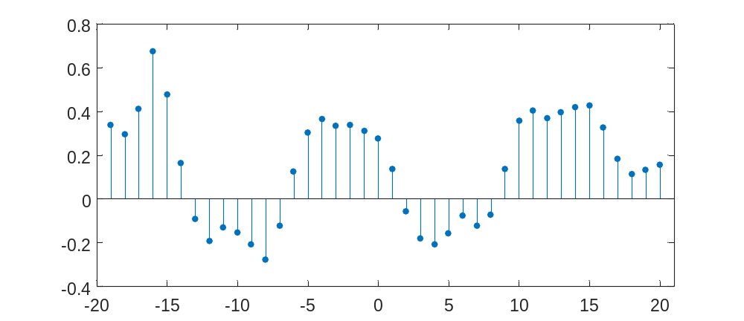
Signals
Sound Image
Discrete-time (sequence)

Slide 2



Systems
$$β$$
$$α$$
Input
+
Output
Input
Output

Slide 3
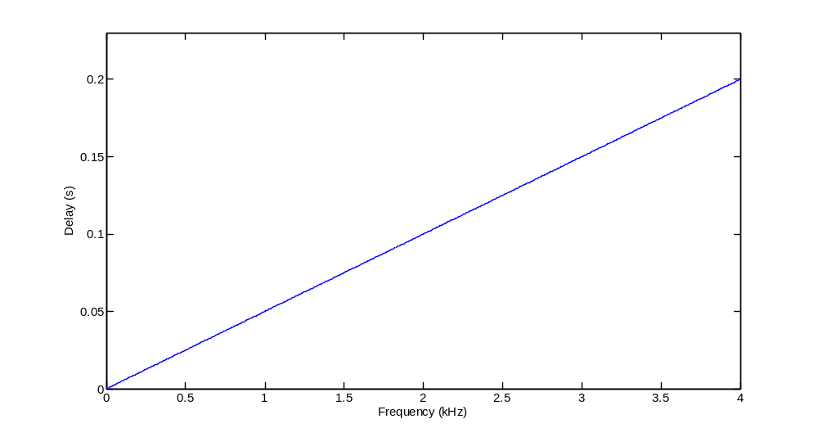
Frequency-dependent delay
Input
Output

Slide 4
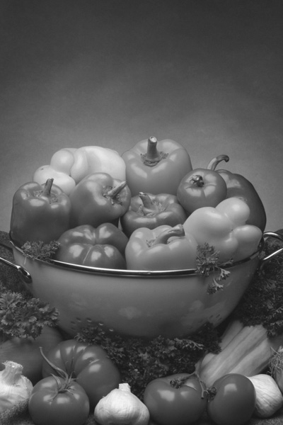


Image processing
Original Blurred Sharpened

Slide 5
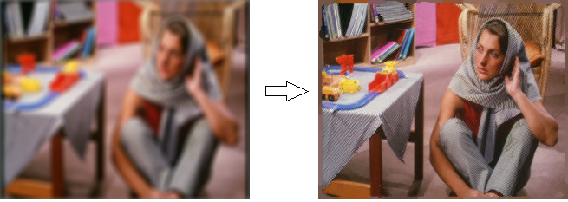
A more elaborate example
Blind deblurring
Original image Deblurred

Slide 6
Digital signal processing is called a “ghost” technology.
It is everywhere, but you don’t see it:
  In your phone, TV, hi-fi, camera, car…
  In boats and planes
  All over the telecommunications networks
  In medical diagnosis equipment (CAT, PET, MR, sonography,…)
  In audio, video and cinema studios
  …

Slide 7
Checking your background
Do you know…?
Discrete-time signal
Discrete-time system
  Properties: linearity, time-invariance, causality, stability
Linear time-invariant system; convolution
Discrete-time Fourier transform

Slide 8
Syllabus
Discrete-time signals and systems – basic concepts.
The discrete-time Fourier transform (DTFT).
The Z transform.
The discrete Fourier transform (DFT).
Digital filters.
Random signals – basic concepts.
Classic parameter estimation.
Bayesian parameter estimation.

Slide 9
Study
4 hours per week
Since the beginning of the semester!
Study the theory (the books, not just some notes or slides)
Solve problems by yourself
Go to the doubts sessions whenever necessary

Slide 10
Faculty
  Luís Borges de Almeida – lectures.
  Margarida Silveira – problems, labs.
  Nuno Monteiro (TA) – problems, labs.
Web page
  www.lx.it.pt/~lbalmeida/pds
Bibliography
  See the web page.

Slide 11
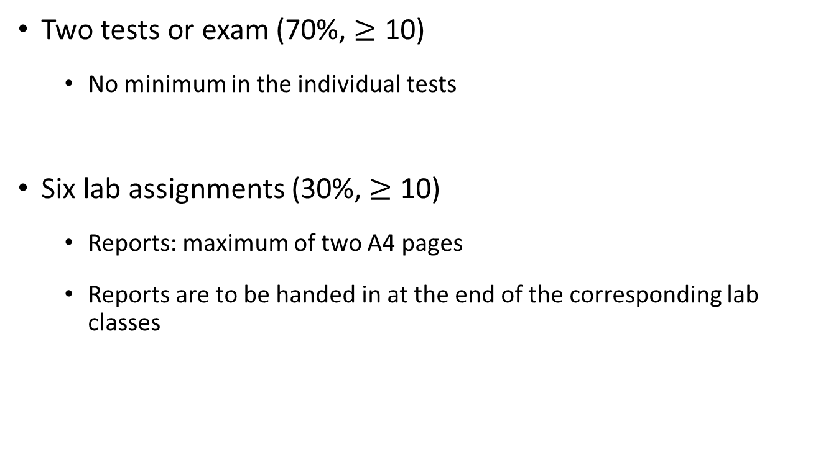
Grading
Two tests or exam (70%, $≥$ 10)
  No minimum in the individual tests
Six lab assignments (30%, $≥$ 10)
  Reports: maximum of two A4 pages
  Reports are to be handed in at the end of the corresponding lab classes

Slide 12
Labs and problems classes
Labs/problems classes from the fenix system are used interchangeably. The first two weeks will be for problems.
The classes of Mondays at 14:00 will not operate (probably).
There are problems classes in the first week of the semester!

Slide 13
Registration for the lab
The registration is done through the fenix system.
See instructions in the web page.
Groups of two students.
Starts on Thursday at 15:00.
At that time, the lab (room 5.13, 5.^{th} floor) will be open.
Prof. Margarida Silveira will be present.

